Slide 1

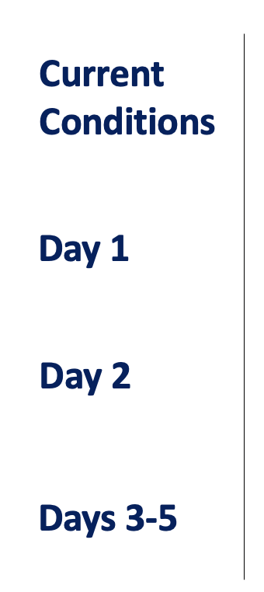
CPEX-CV Forecast
September 1, 2022
Lead name, Support name, Support Name, Support Name
XXX.
XXX.
XXX.
XXX.

Slide 2
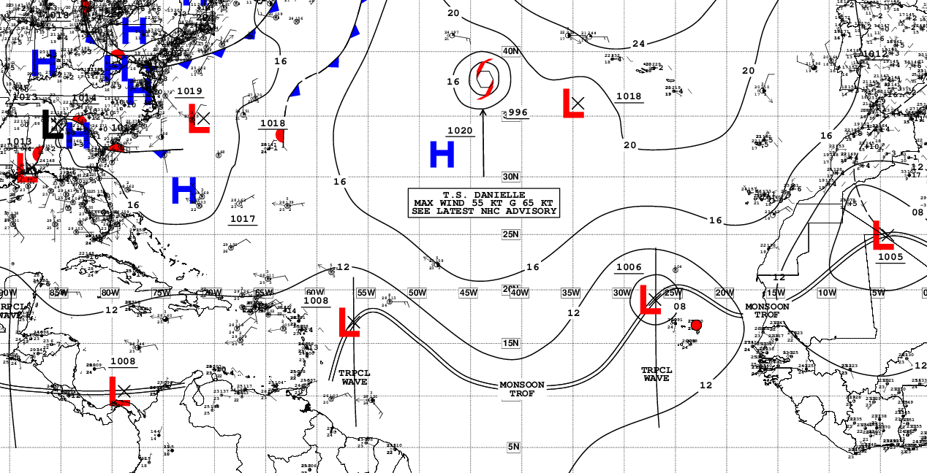
Current Conditions – Synoptic View
NHC Surface Analysis (XXZ)
…
…

Slide 3
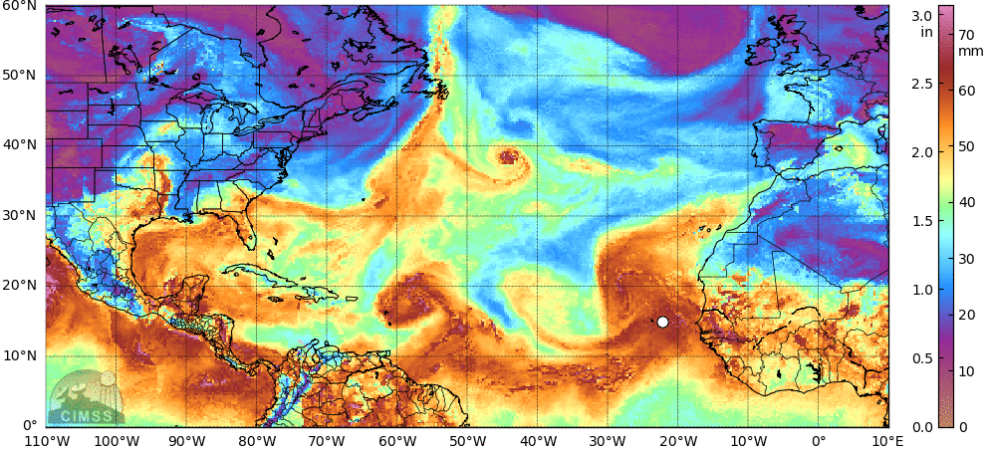
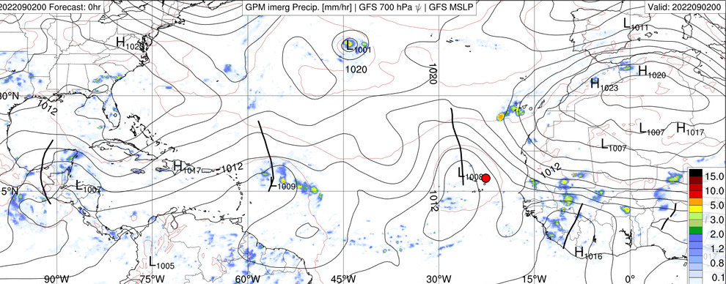
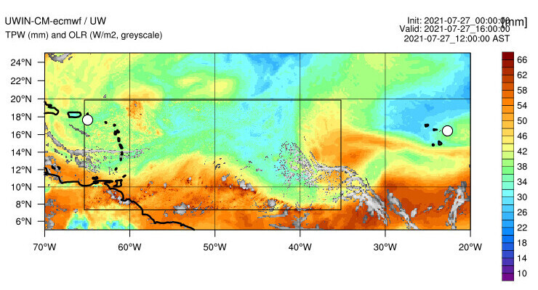
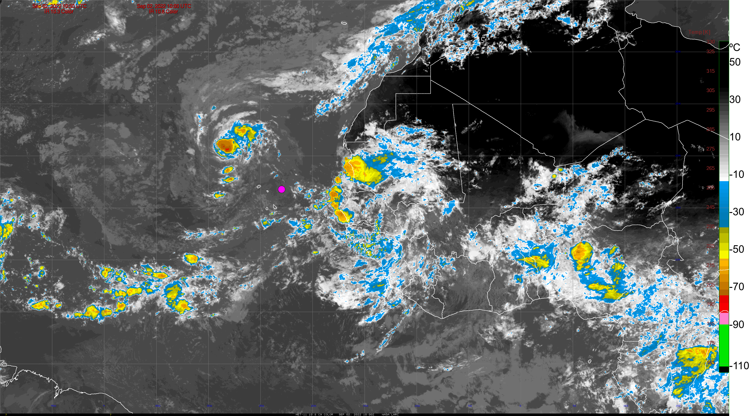
Current Conditions – AEWs and ITCZ
Total Precipitable Water (XXZ) – MIMIC
IMERG Rain Rate, MSLP, AEWs (XXZ) – GFS
Model OLR, TPW (XXZ) – UWIN-CM
GOES-16 / Meteosat-11 IR (XX:XXZ)

Slide 4
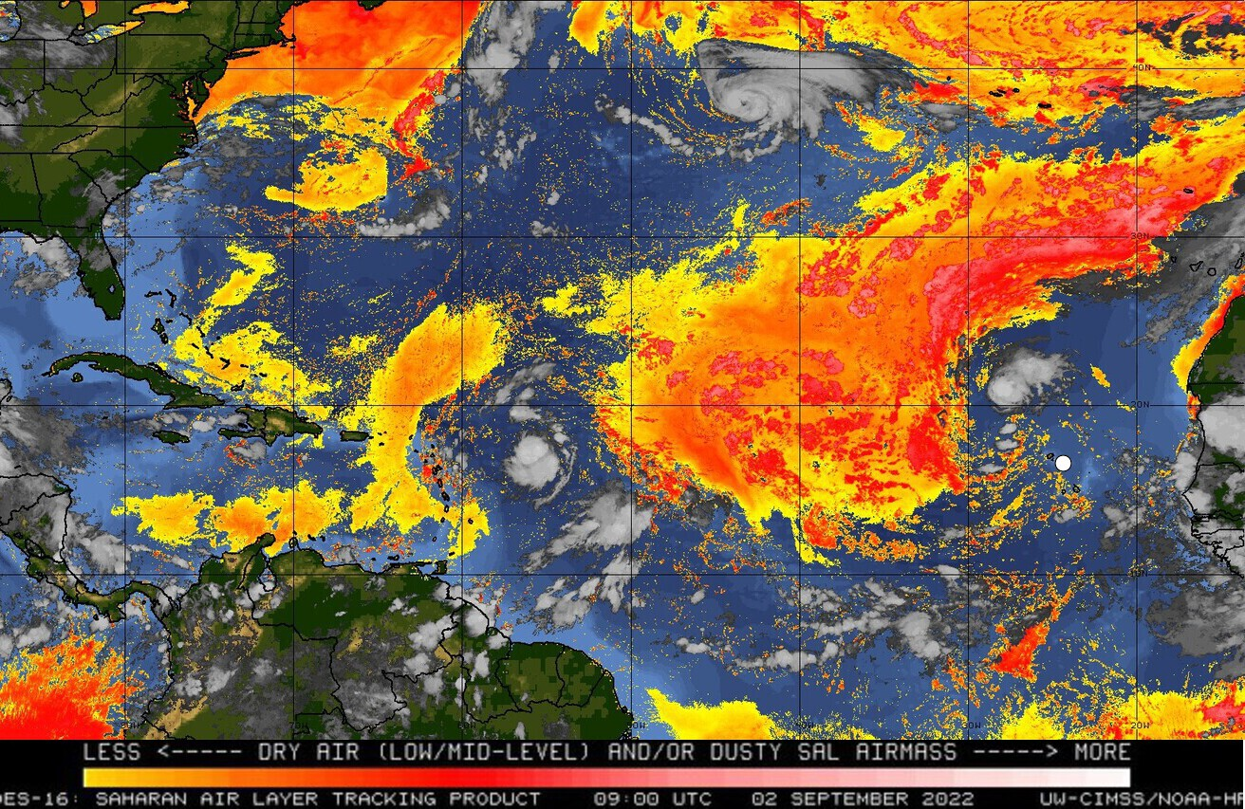
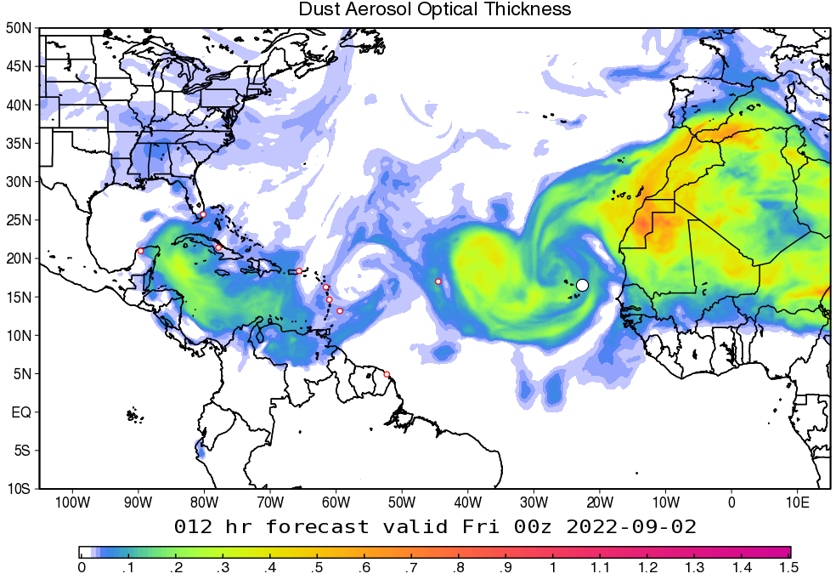
Current Conditions – Dust and Aerosols
SAL (split window, XXZ) – GOES-16
GEOS Dust Aerosol Optical Thickness – GEOS
…

Slide 5
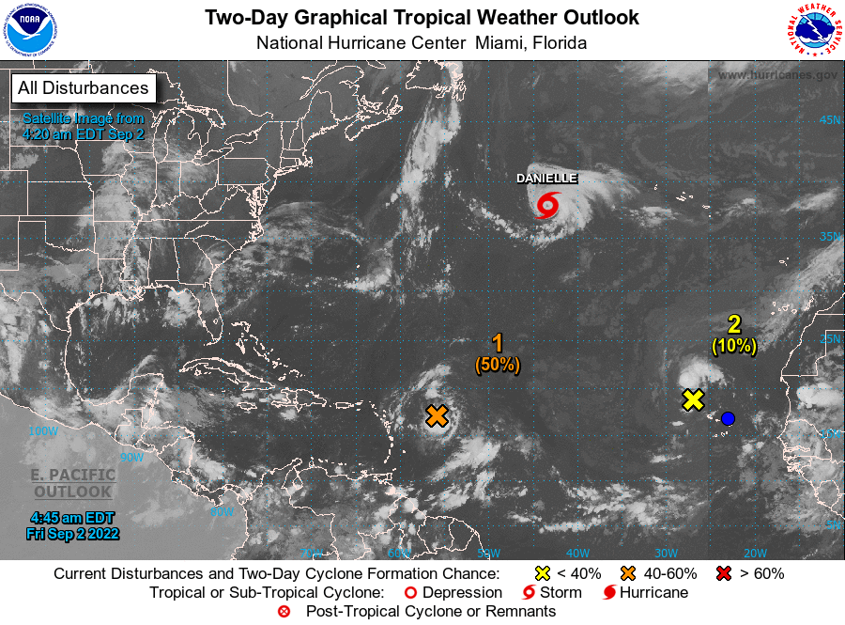
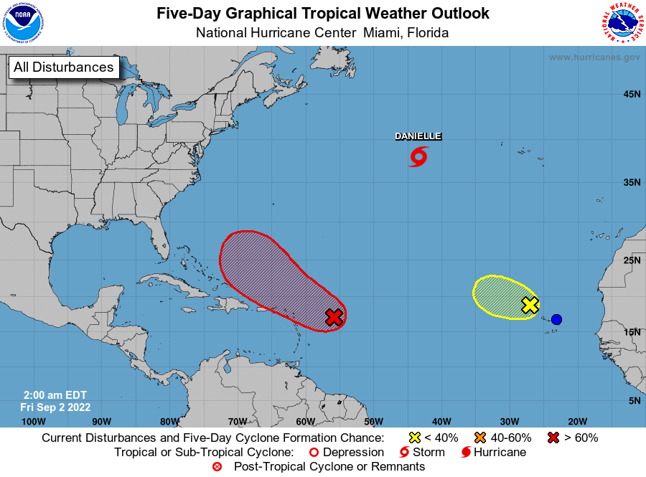
NHC Tropical Atlantic Outlook
(Sept. 3 & Sept. 6, 2022)
2-day Outlook
5-day Outlook
…

Slide 6
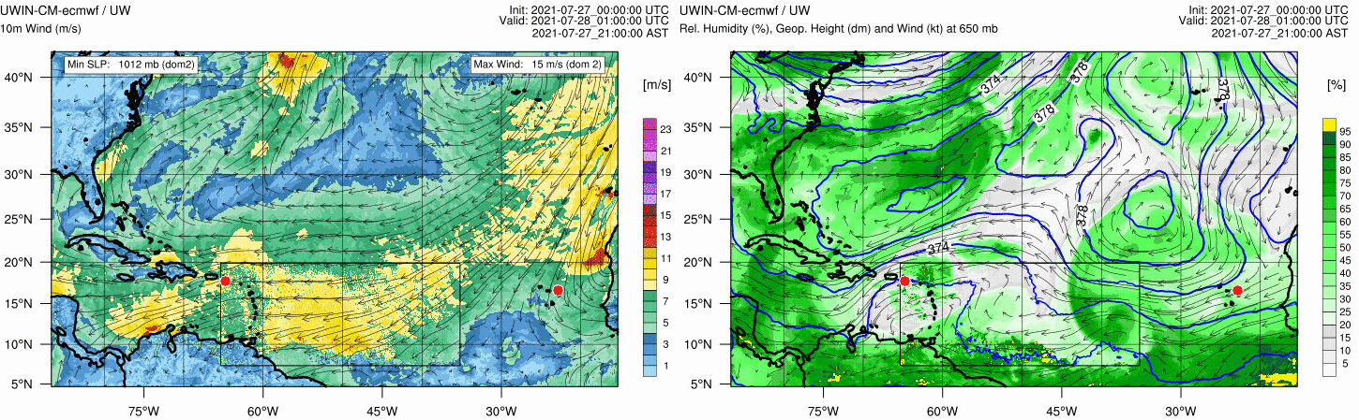
Forecast – day 1
(Sept. 2, 2022)
10m Winds – UWIN-CM
650mb RH, Geopotential Height, Winds – UWIN-CM
…
…

Slide 7
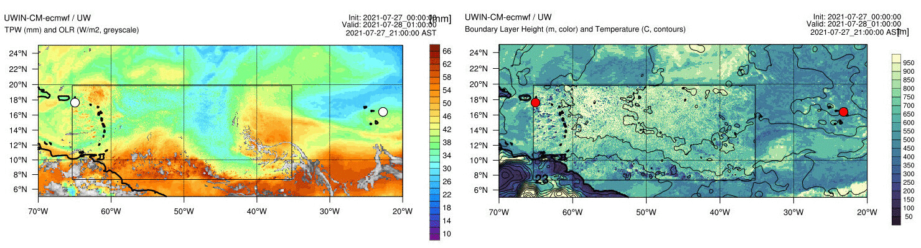
Forecast – day 1
(Sept. 2, 2022)
TPW, OLR – UWIN-CM
PBL Height and Temperature – UWIN-CM
…
…

Slide 8
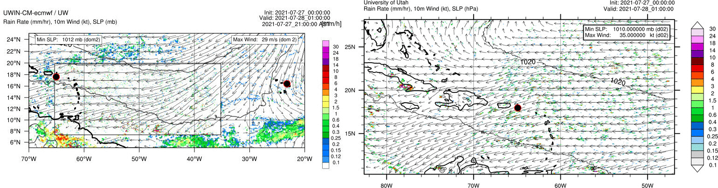
Forecast – day 1
(Sept. 2, 2022)
10m Winds, MSLP, Rain – UWIN-CM
10m Winds, MSLP, Rain – U. of Utah WRF
…
…

Slide 9
Forecast – day 2
(Sept. 3, 2022)
10m Winds – UWIN-CM
650mb RH, Geopotential Height, Winds – UWIN-CM
…
…

Slide 10
Forecast – day 2
(Sept. 3, 2022)
TPW, OLR – UWIN-CM
PBL Height and Temperature – UWIN-CM
…
…

Slide 11
Forecast – day 2
(Sept. 3, 2022)
10m Winds, MSLP, Rain – UWIN-CM
10m Winds, MSLP, Rain – U. of Utah WRF
…
…

Slide 12
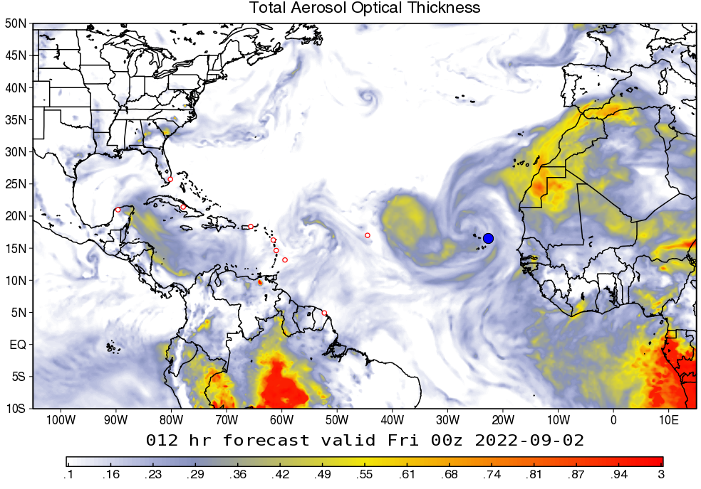
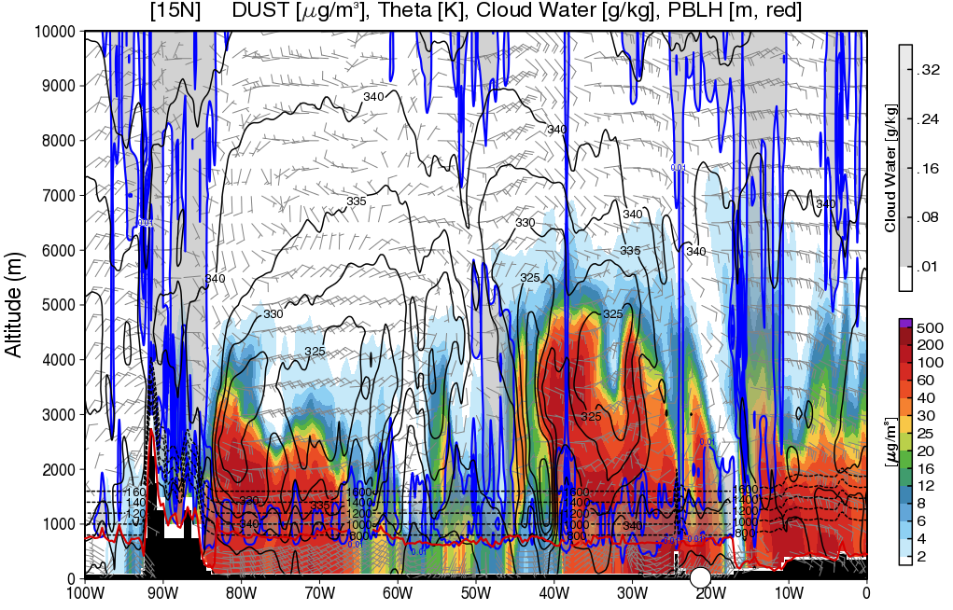
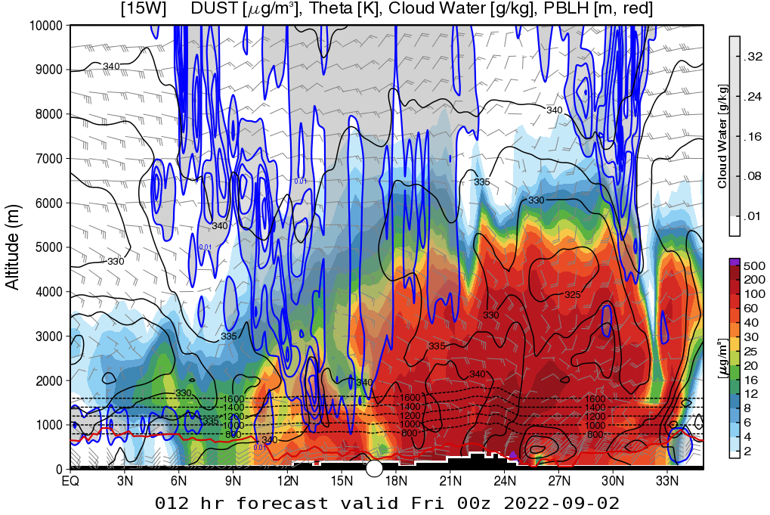
Dust and Aerosols – Current
(Sept. 1, 2022)
Total AOT – GEOS
Dust cross-section at 15°N
…
Dust AOT – GEOS
Dust cross-section at 20°W

Slide 13
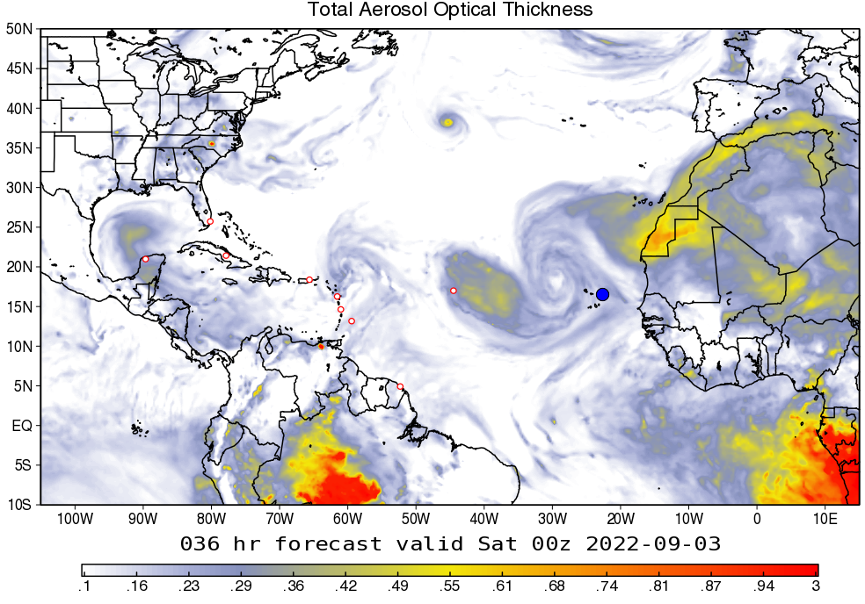
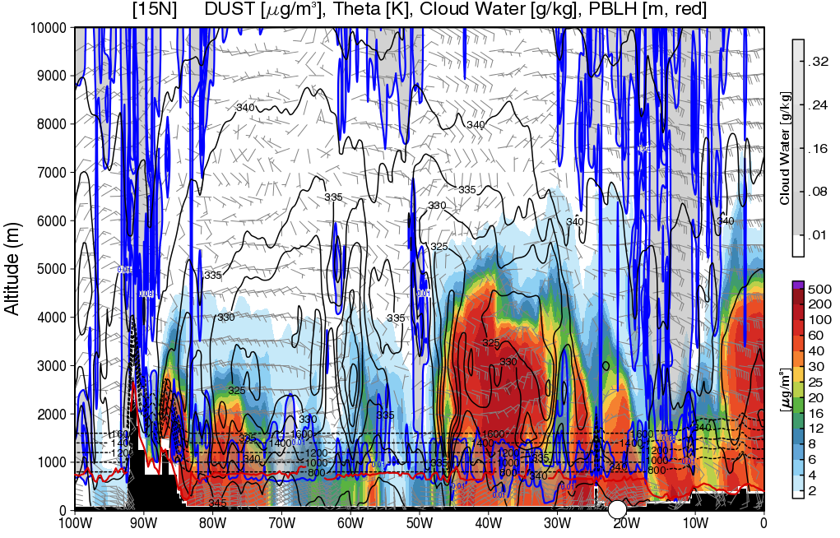
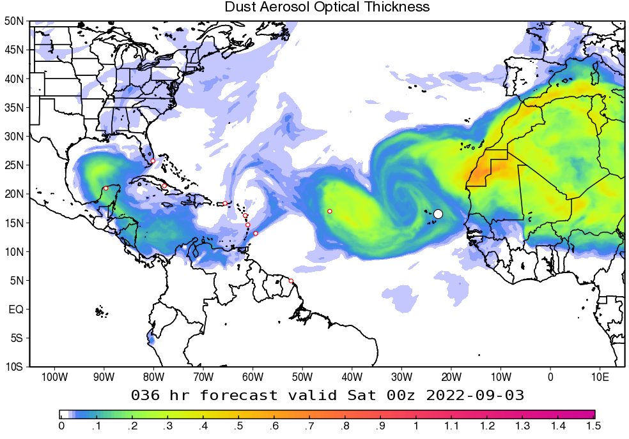
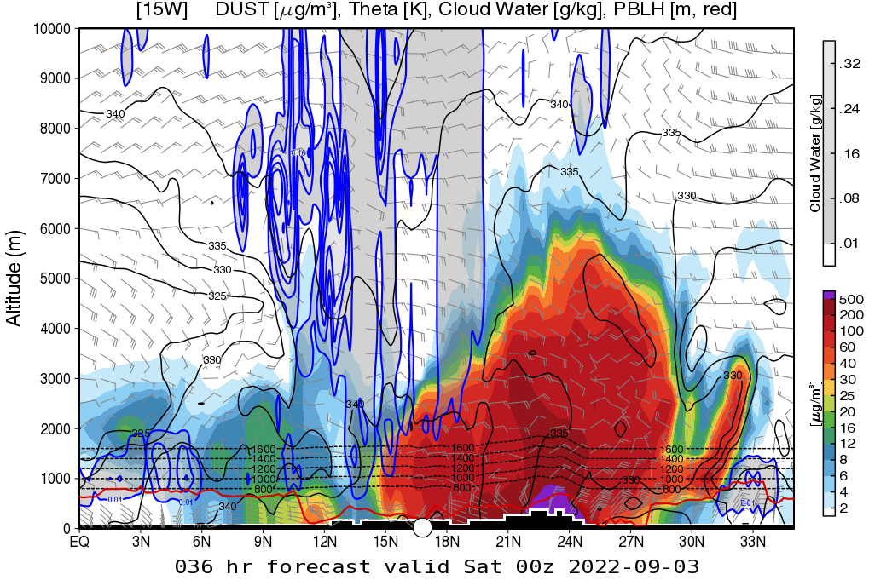
Dust and Aerosols – Day 1
(Sept. 2, 2022)
Total AOT – GEOS
Dust cross-section at 15°N
…
Dust AOT – GEOS
Dust cross-section at 20°W

Slide 14
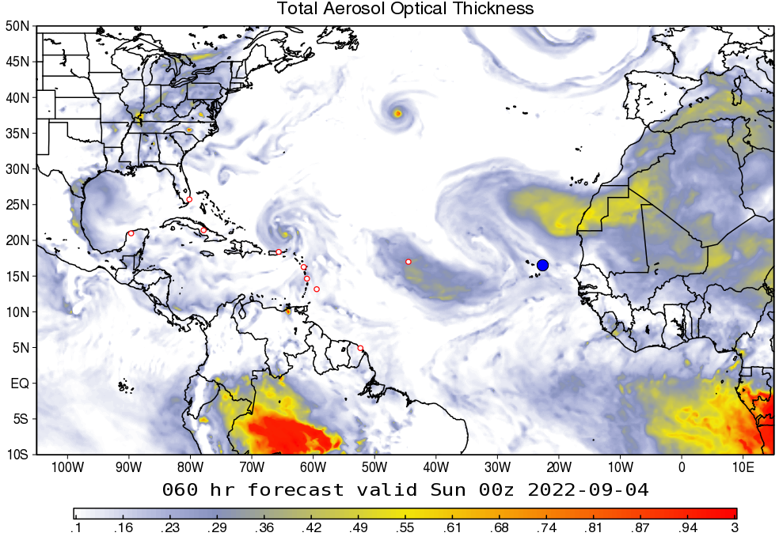
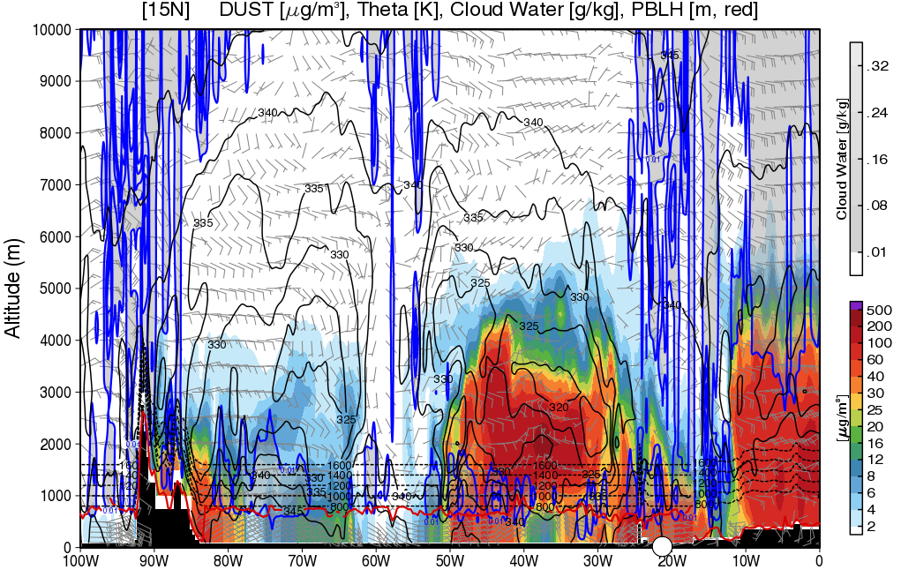
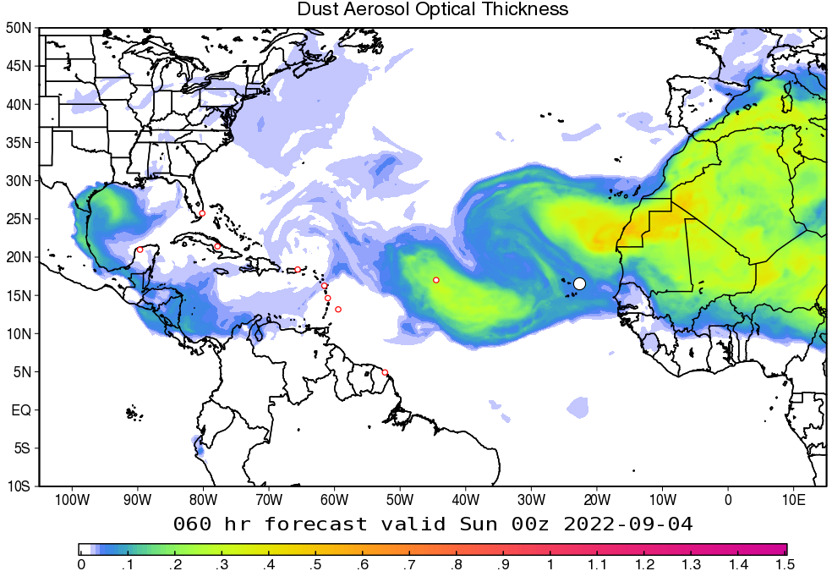
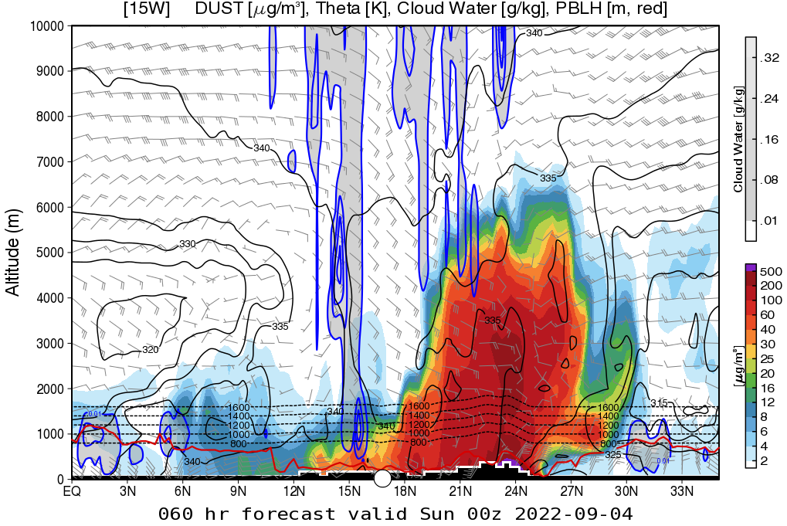
Dust and Aerosols – Day 2
(Sept. 3, 2022)
Total AOT – GEOS
Dust cross-section at 15°N
…
Dust AOT – GEOS
Dust cross-section at 20°W

Slide 15
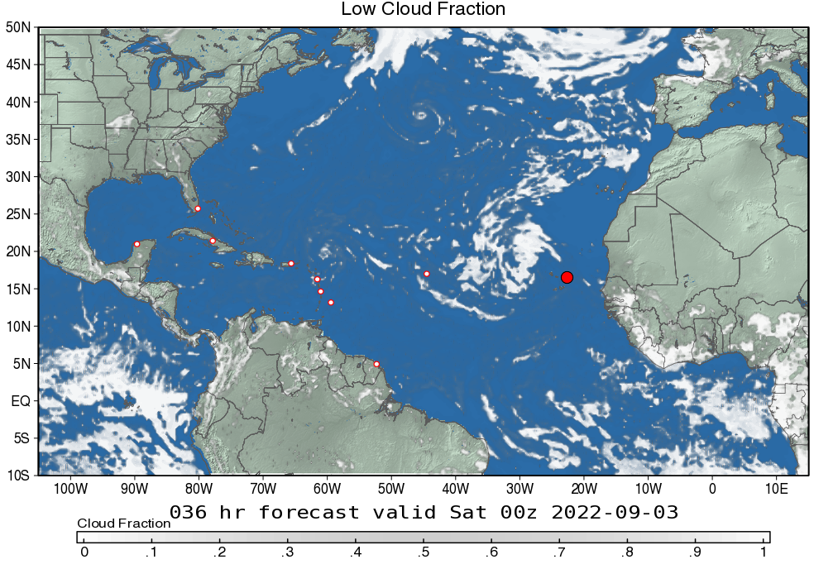
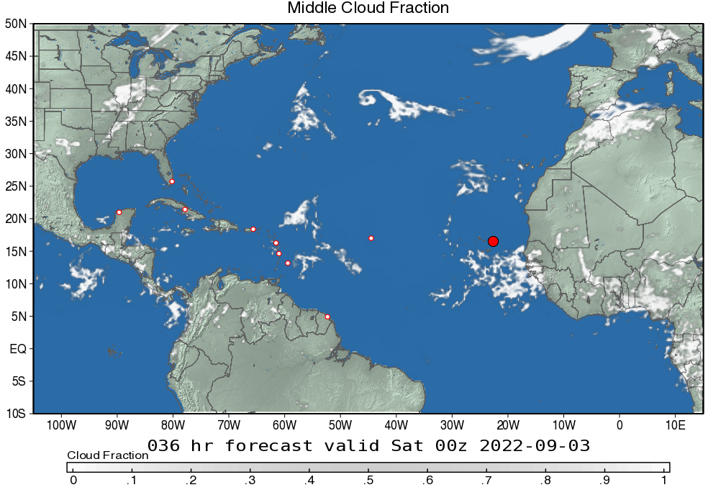
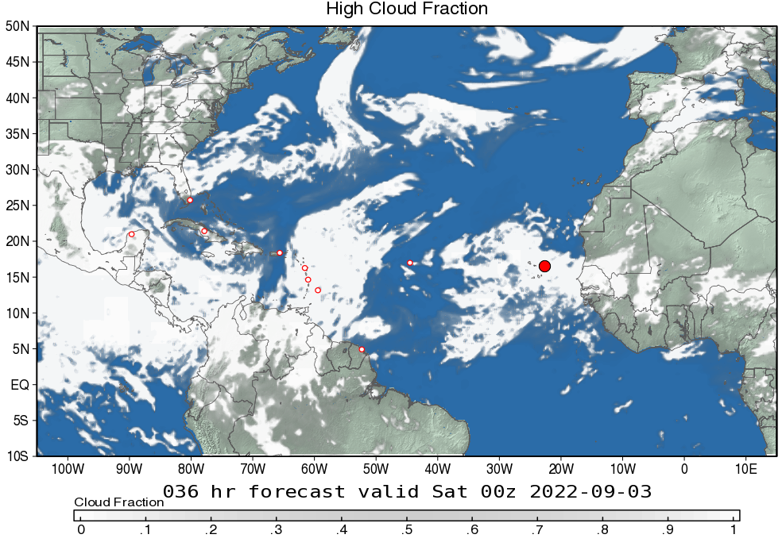
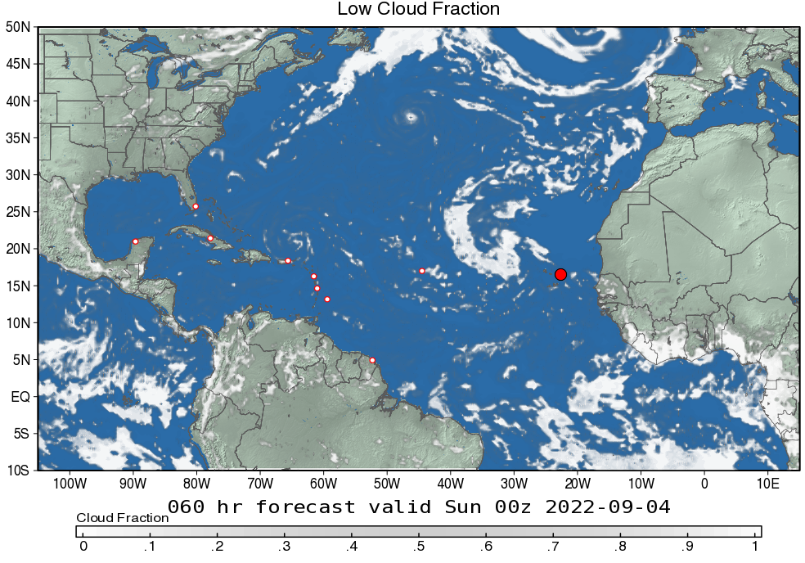
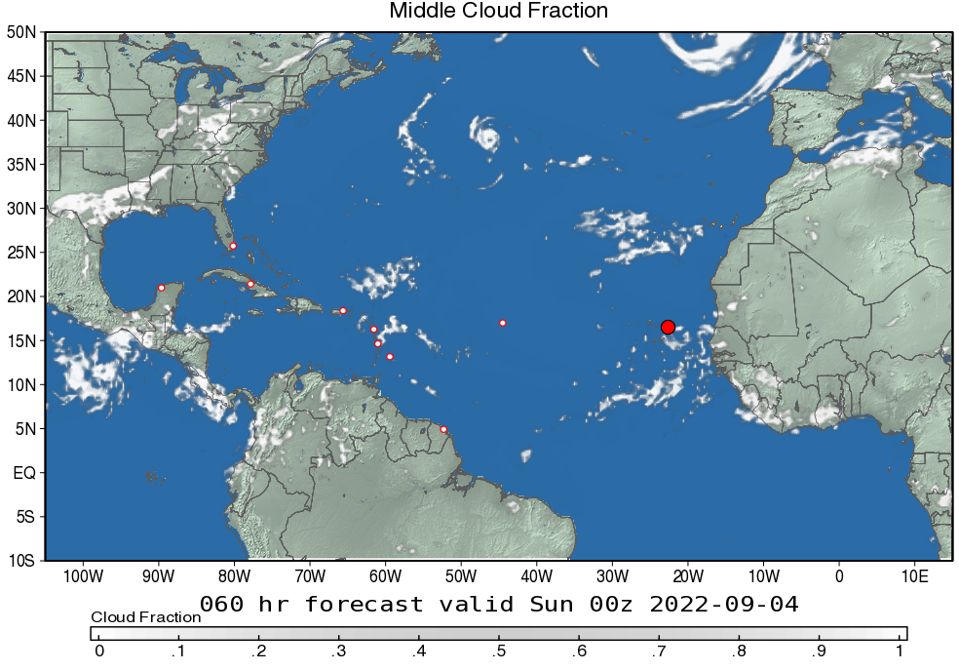
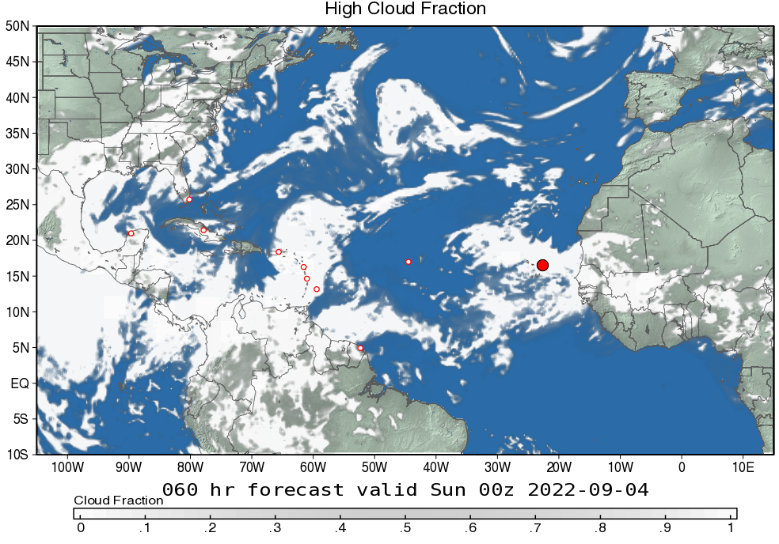
Cloud Fraction – days 1 & 2
(Sept. 2 & 3, 2022)
Day 1
Low cloud fraction (> 700 mb) – GEOS
Middle cloud fraction (700-400 mb) – GEOS
High cloud fraction (< 400 mb) – GEOS
Day 2
Low cloud fraction (> 700 mb) – GEOS
Middle cloud fraction (700-400 mb) – GEOS
High cloud fraction (< 400 mb) – GEOS

Slide 16
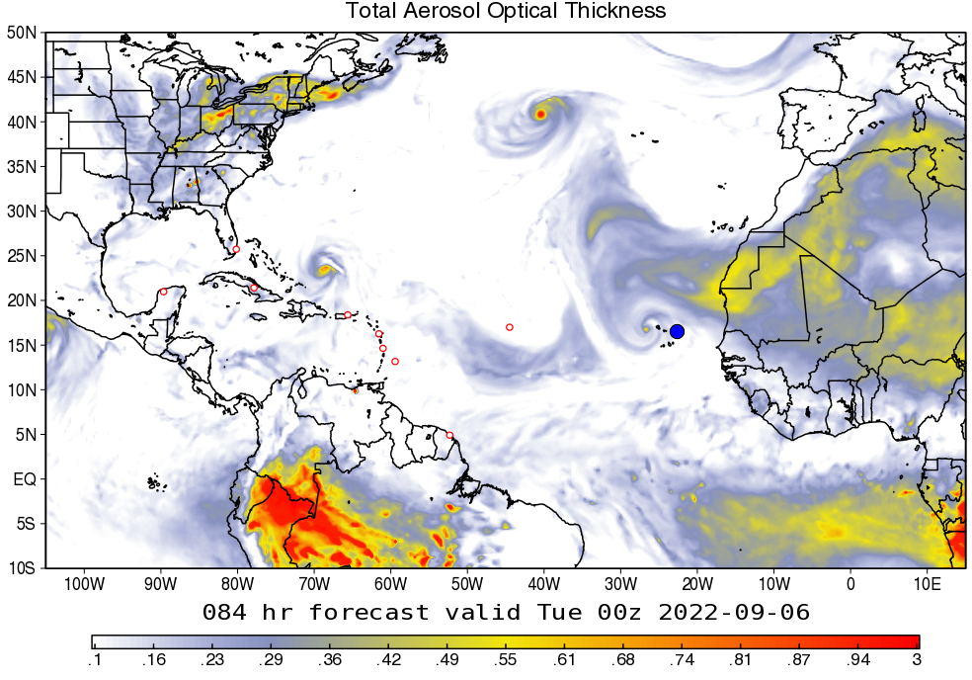
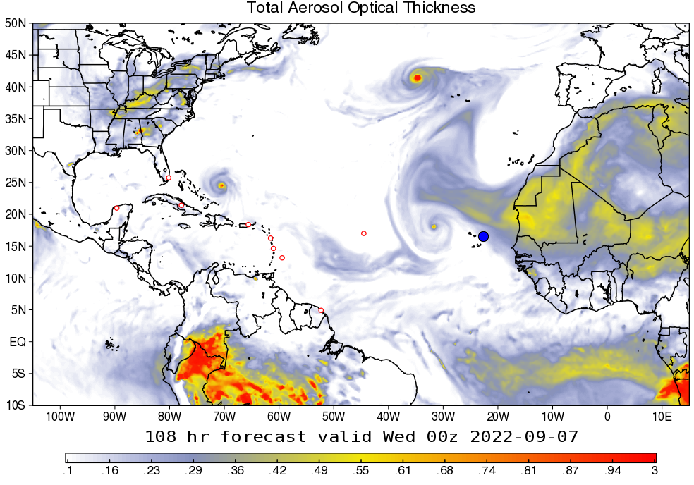
Dust and Aerosols Outlook – Days 3 & 4
(Sept. 4 & 5, 2022)
Ensemble Mean Total AOT – GEOS (day 3)
Ensemble Mean Total AOT – GEOS (day 4)
…

Slide 17
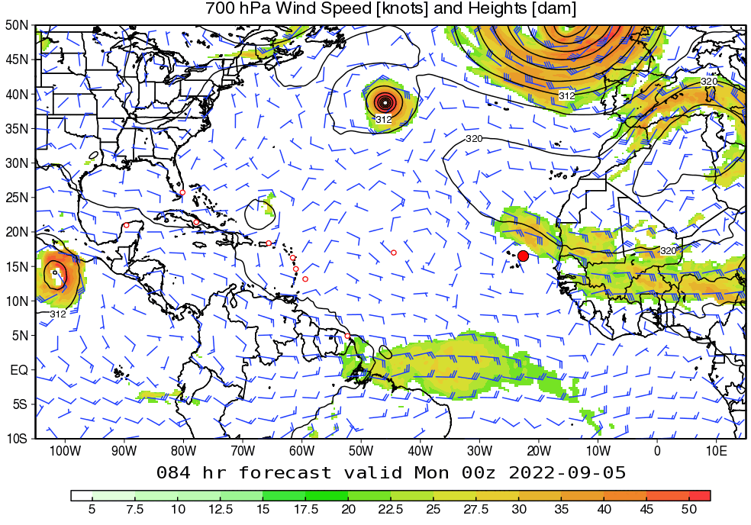
Dynamical Outlook – Days 3-4 (SAL Jet)
(Sept. 4 & 5, 2022)
700mb Winds and Geopotential Height – GEOS
…

Slide 18
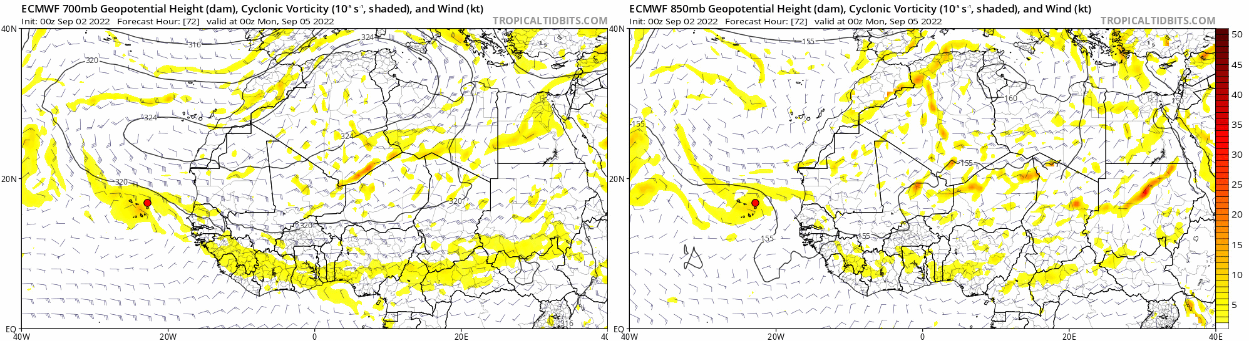
Dynamical Outlook – Days 3-5 (AEWs)
(Sept. 4 – Sept. 6, 2022)
700mb Vorticity, Geopotential Height, Winds – ECMWF
850mb Vorticity, Geopotential Height, Winds – ECMWF
…

Slide 19
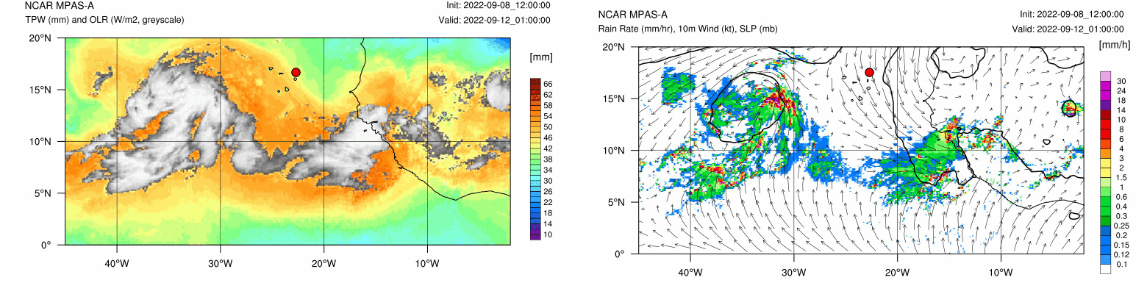
TPW, Precipitation Outlook – Days 3-4
(Sept. 4 & 5, 2022)
TPW, OLR – MPAS
10m Winds, Hourly Rain Rate – MPAS
…
…

Slide 20
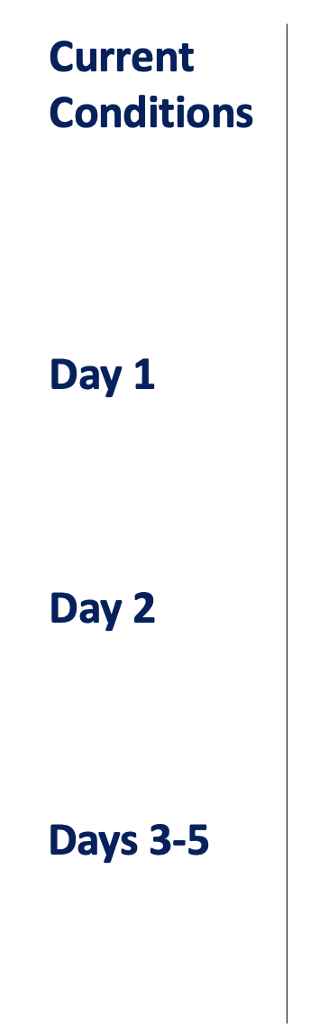
Summary
XXX.
XXX.
XXX.
XXX.

